Slide 1

Studies on structural optimality of plant stems
Indian Institute of Technology Kanpur
Department of Mechanical Engineering
Rohit Gupta
Thesis Supervisor
Dr. Sumit Basu

Slide 2
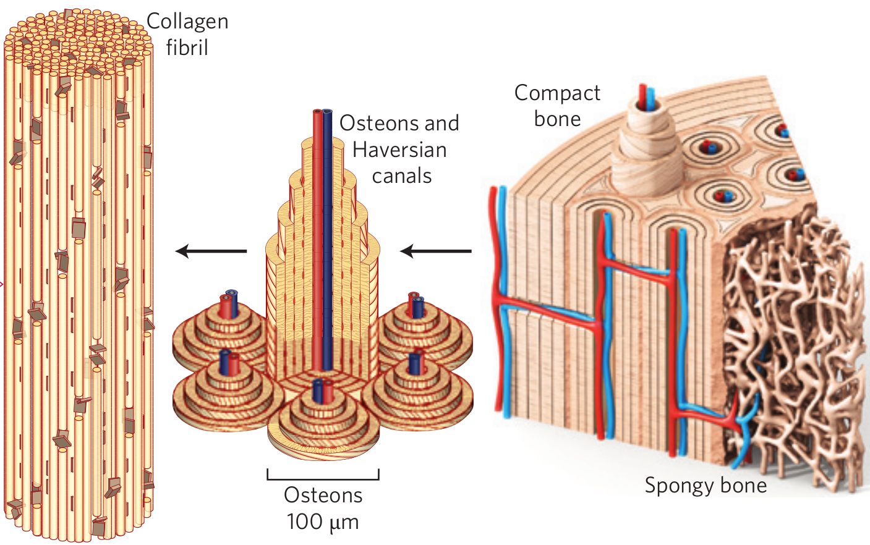
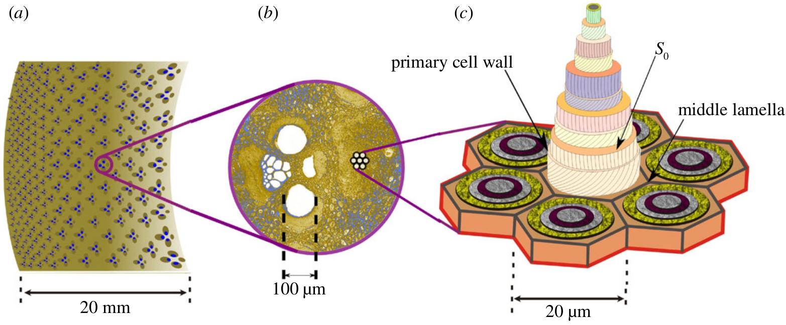
Structure of plant stems
Plants stems like other natural structures have an hierarchical organisation of a soft and a hard material.
Bones have two components one is compact bone and other is sponge bone.
Bamboo consists of long cellulose fibers distributed in a matrix of parenchyma cell which are made of lignin-carbohydrate complex. Parenchyma matrix act as soft sponge and provide flexibility while fibers provide the strength.
Using complex hierarchical organisation two or more different types of material natural structures can have properties exceeding the properties of their constituents.
Figure: Hierarchical structure of bamboo
Figure: Hierarchical structure of bones

Slide 3
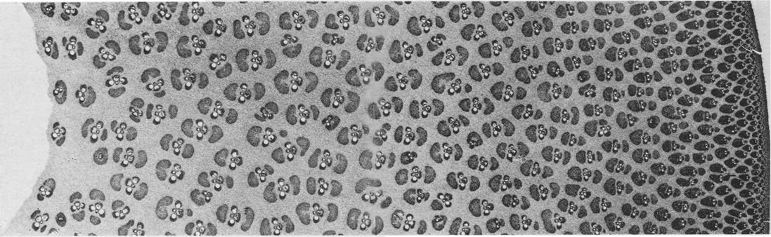
Distribution of material
Fibers appears in bundles throughout the cross-section though their density varies. Fibers are more dense and more tensile strength as compared to parenchyma cells.
The density of fiber bundles increases as we move outward from the inner radius. This increases the strength and the moment about the axis. It seems that bamboo is trying to add reinforcement only where it is necessary.
Thus, overall distribution is trying to increase the EI/⍴ of the overall structure.
Figure: Clipped cross-section of bamboo

Slide 4
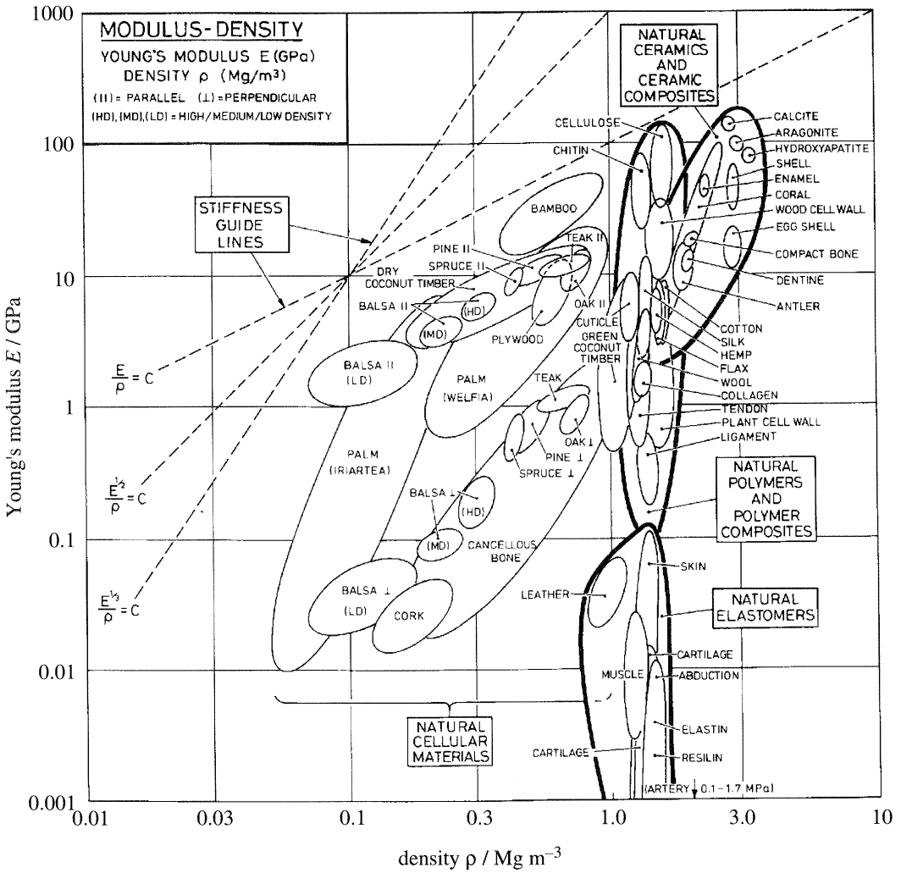
Is This Strategy Optimal?
There may be other biological factors influencing the distribution of material.
The quantity EI/⍴ represent specific flexural rigidity. Flexural rigidity is defined as the force couple required to bend a non-rigid structure in one unit of curvature or it can be defined as the resistance offered by a structure while undergoing bending.
Also, from previous studies, we can see that bamboo has much better E^⅓/⍴ than its components cellulose and parenchyma cell wall.

Slide 5
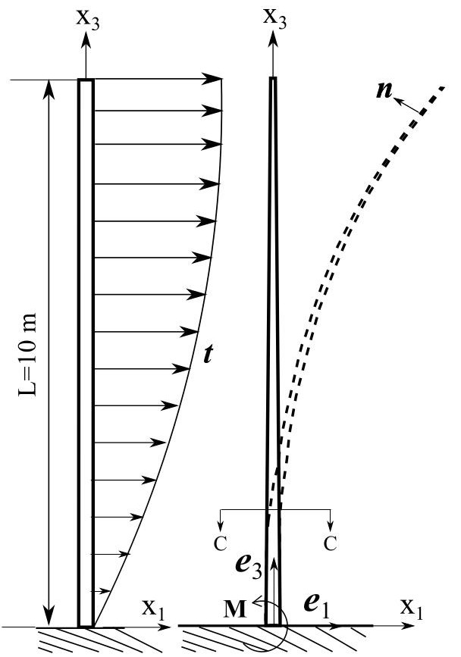
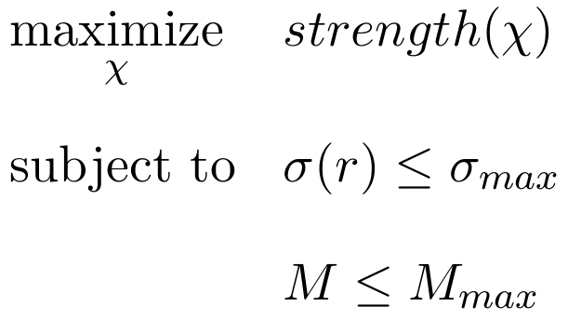
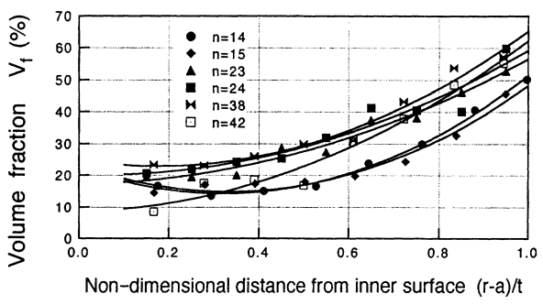
The 1D Problem
Find the optimal areal distribution of parenchyma cells and fibres such as to maximize specific flexural rigidity subject to the loading constraints applicable to the bamboo.

Slide 6
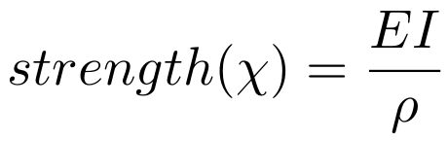
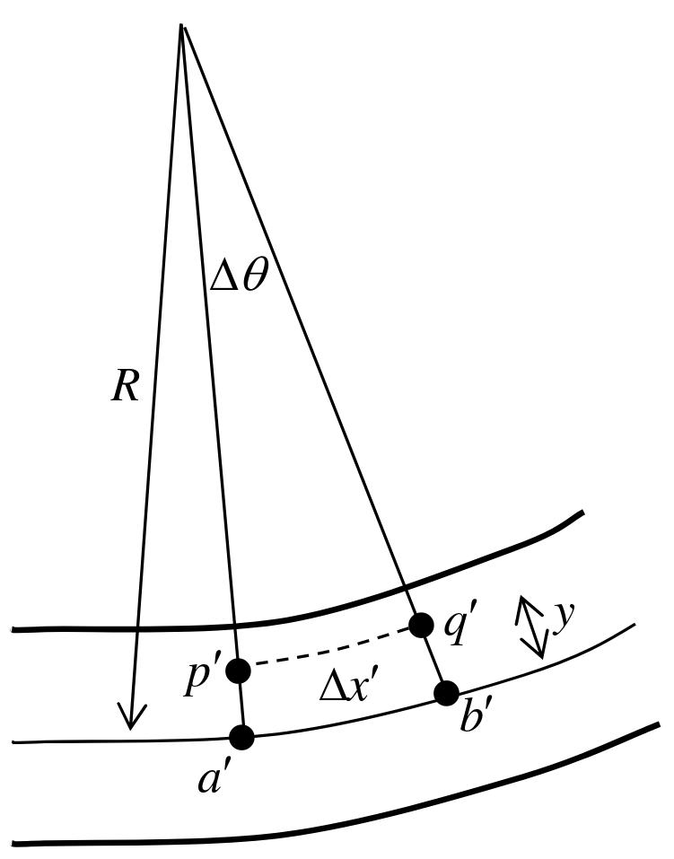
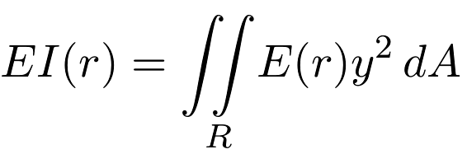
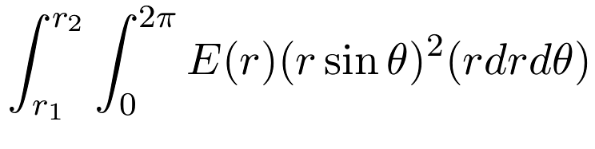
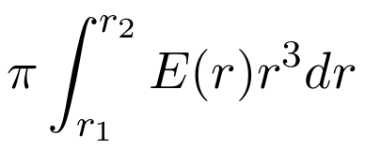
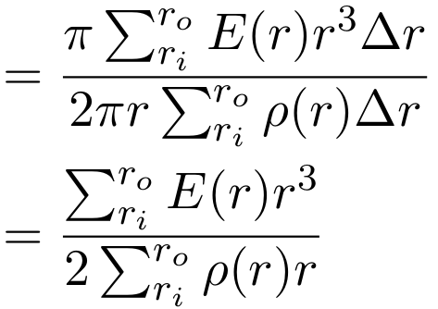
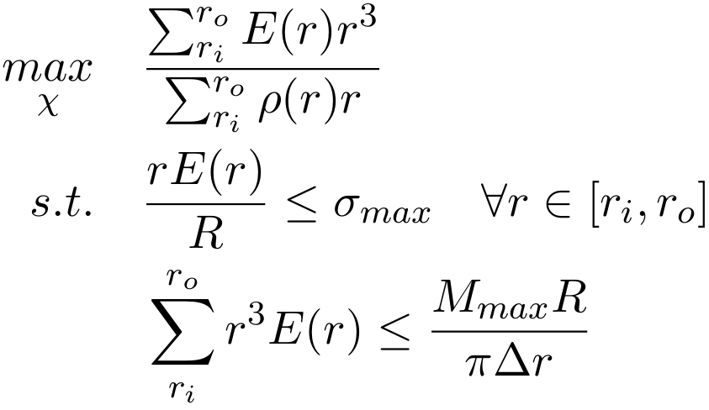
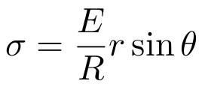
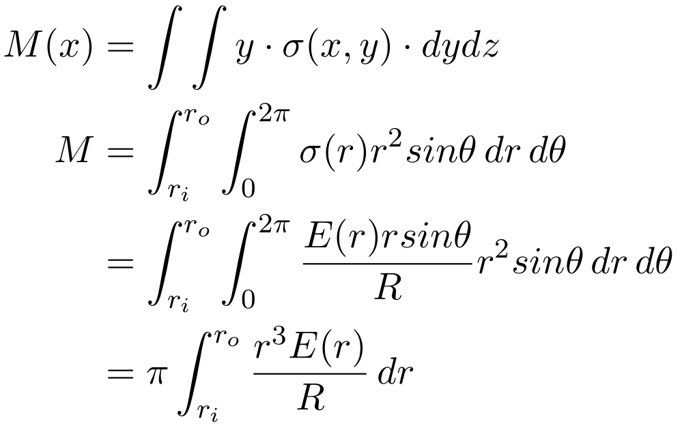
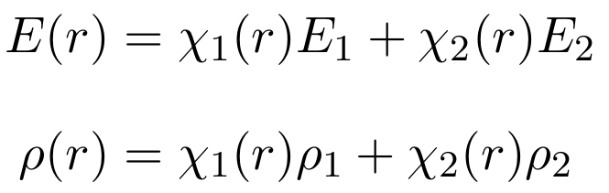
The 1D Problem
Figure: Schematic for Euler-Bernoulli Beam Theory

Slide 7
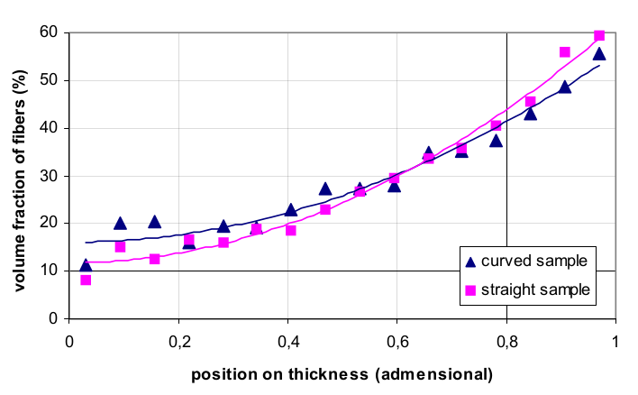
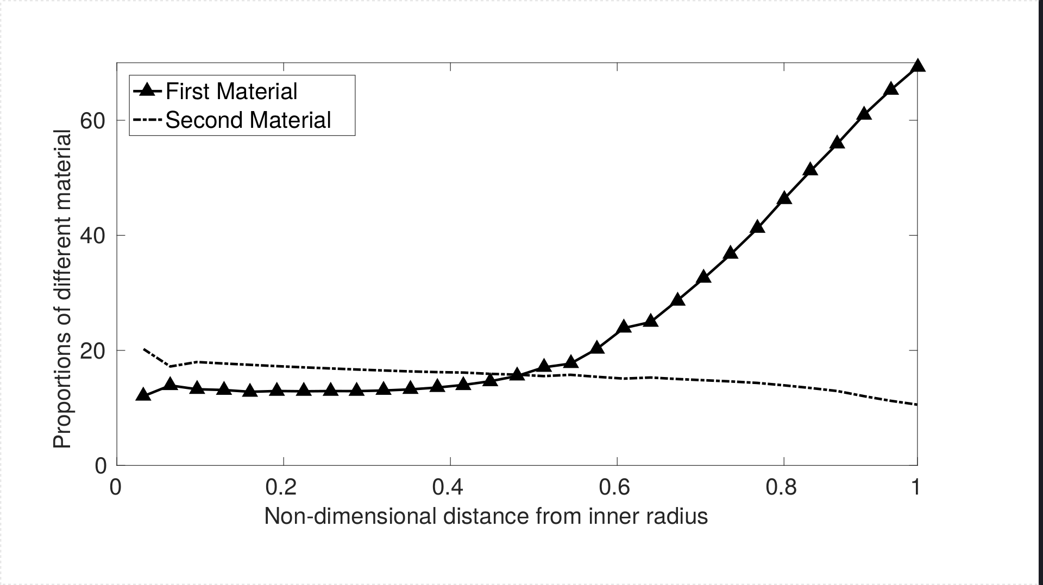
1D Results

Slide 8
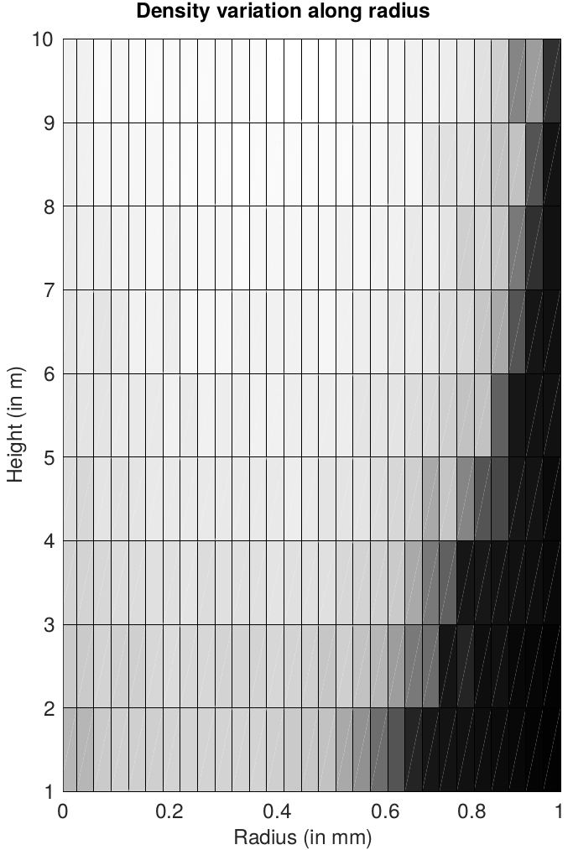
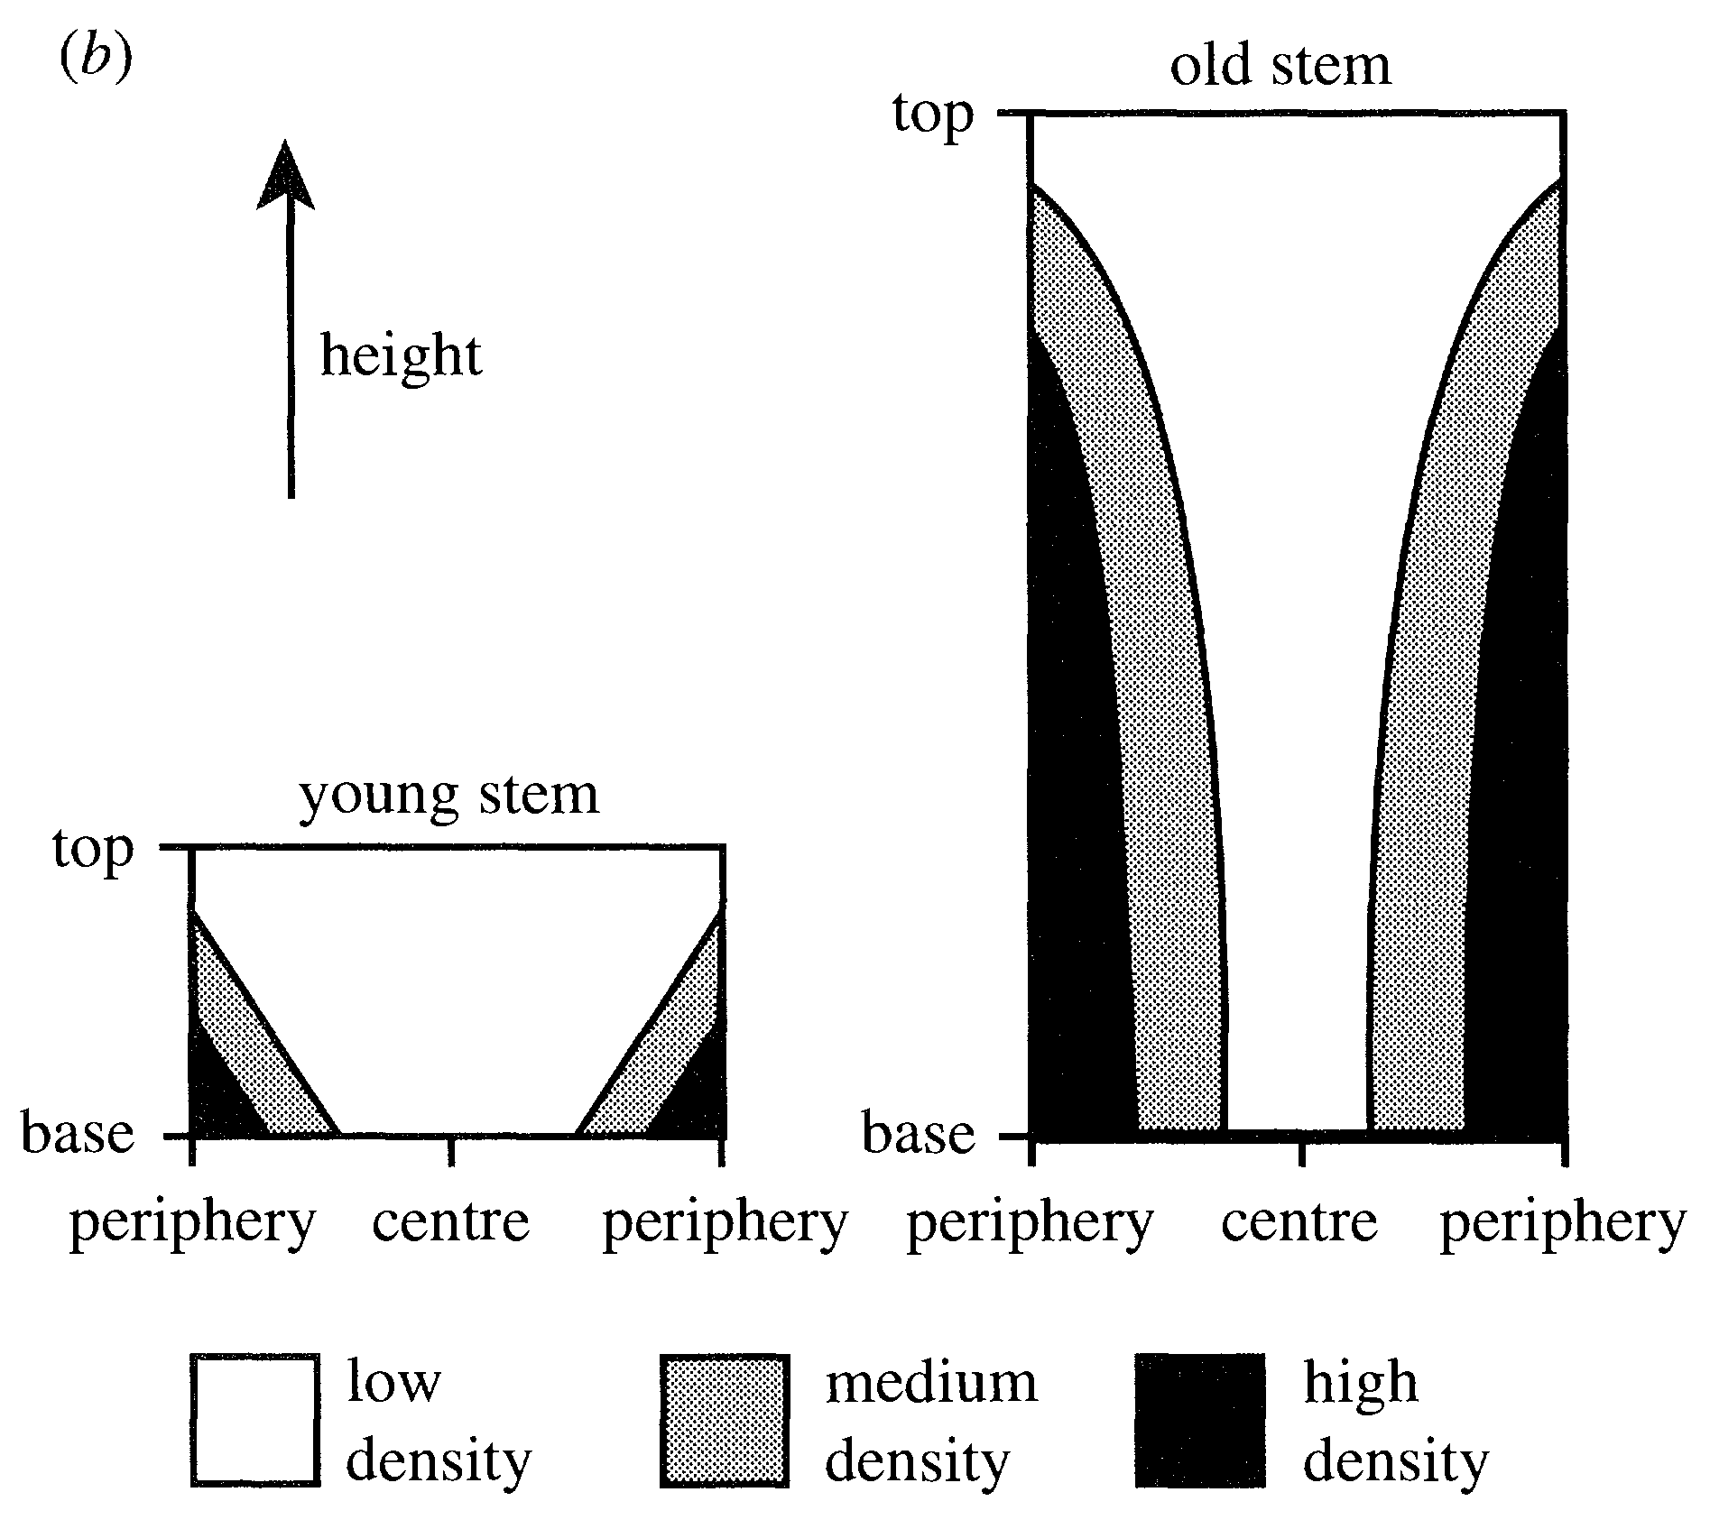
1D Results

Slide 9
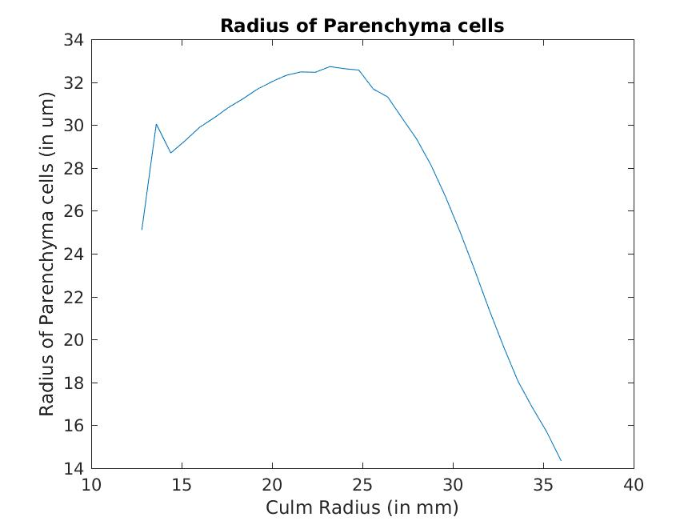
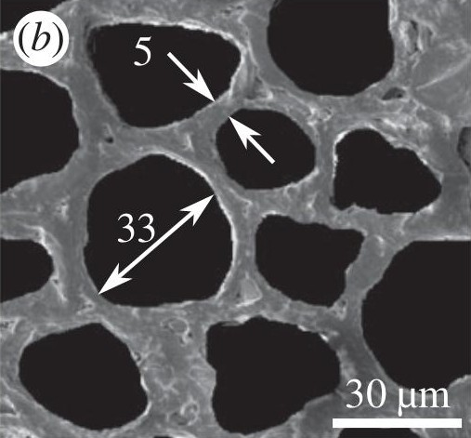
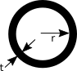
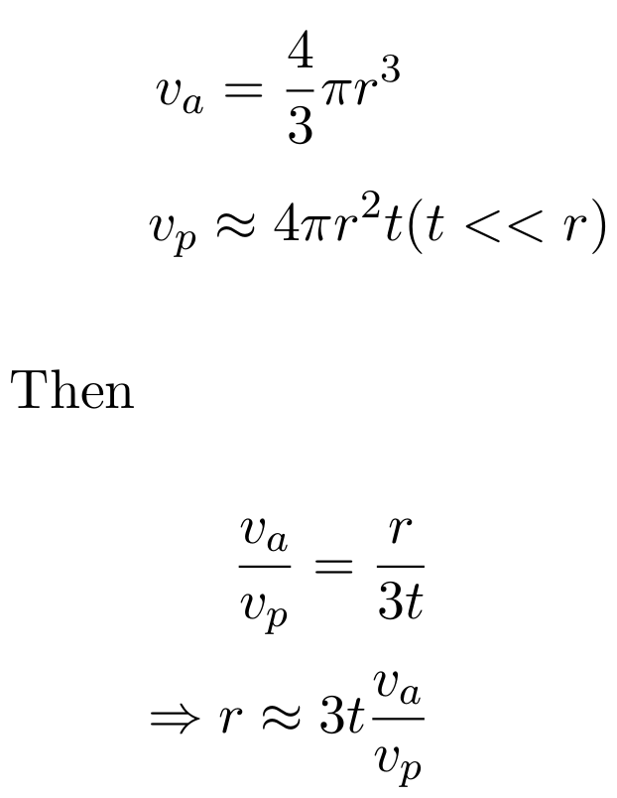
Cell size

Slide 10
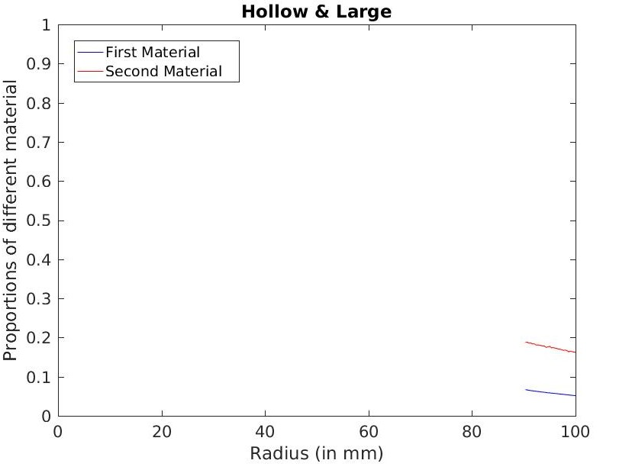
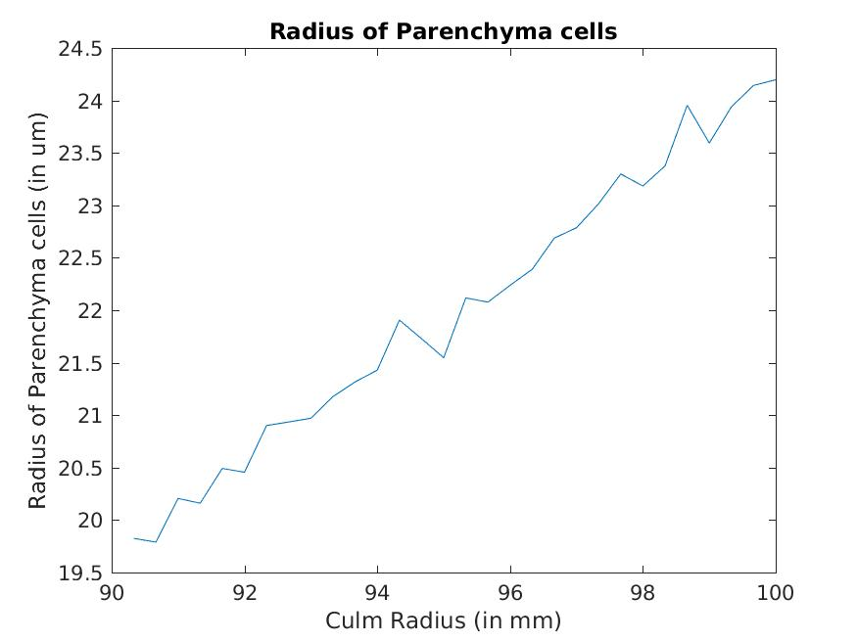
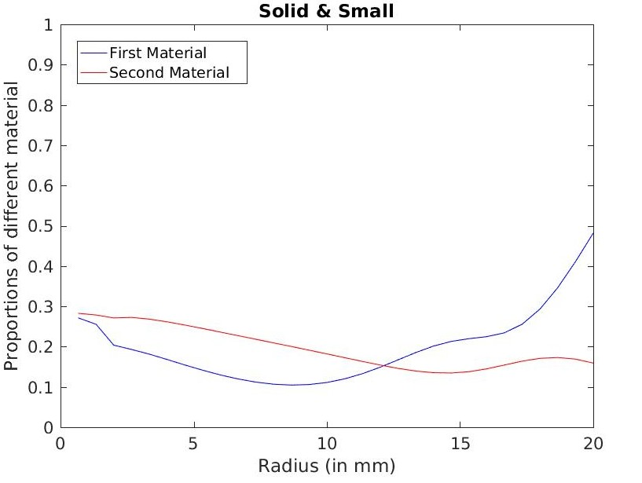
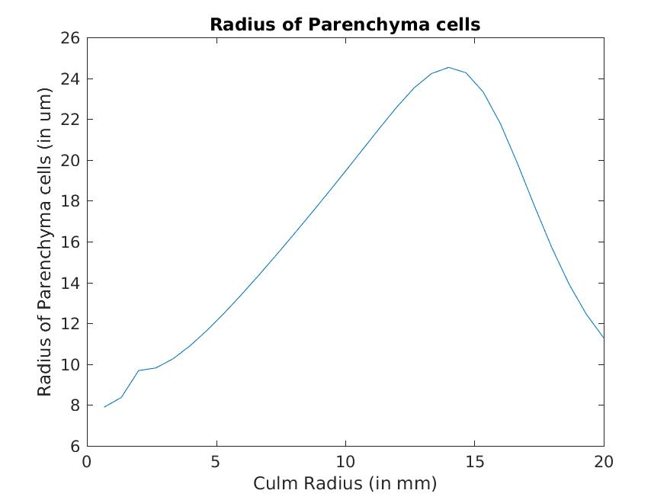
Other Predictions

Slide 11
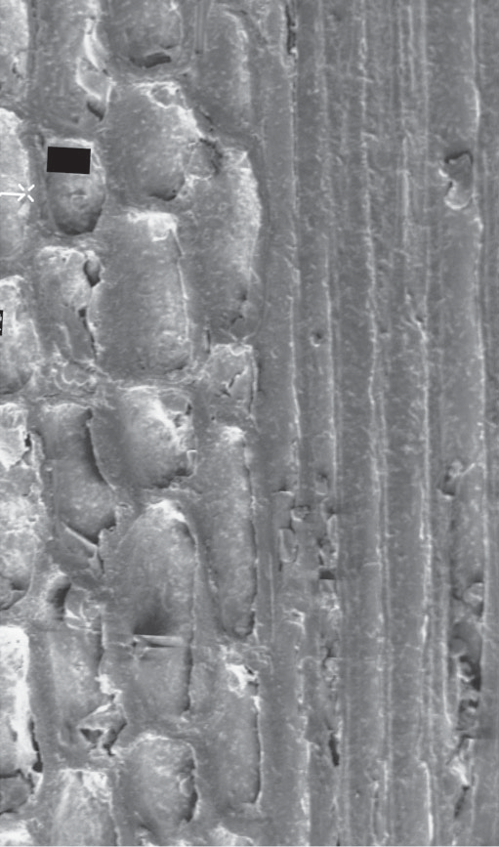
Microstructure
The radial distribution of materials in bamboo is optimal from the perspective of specific flexural rigidity.
Next question is, what about the optimality of the microstructure of bamboo?
For this we need to generate optimal structures with some objective function and then we can compare it with the actual structures that appear in bamboos.
In the next section, we will discuss the process for obtaining optimal microstructures. We have not been able to test the code for different objective function to answer the question.
Figure: Microstructure of bamboo

Slide 12
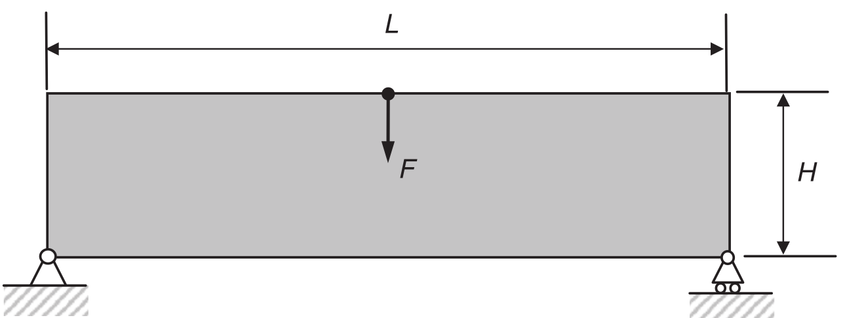
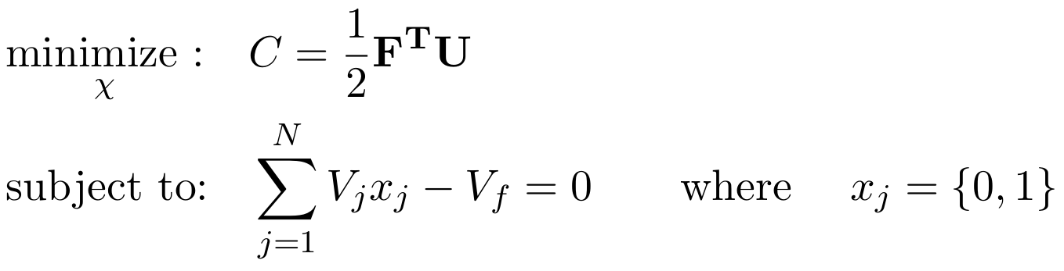
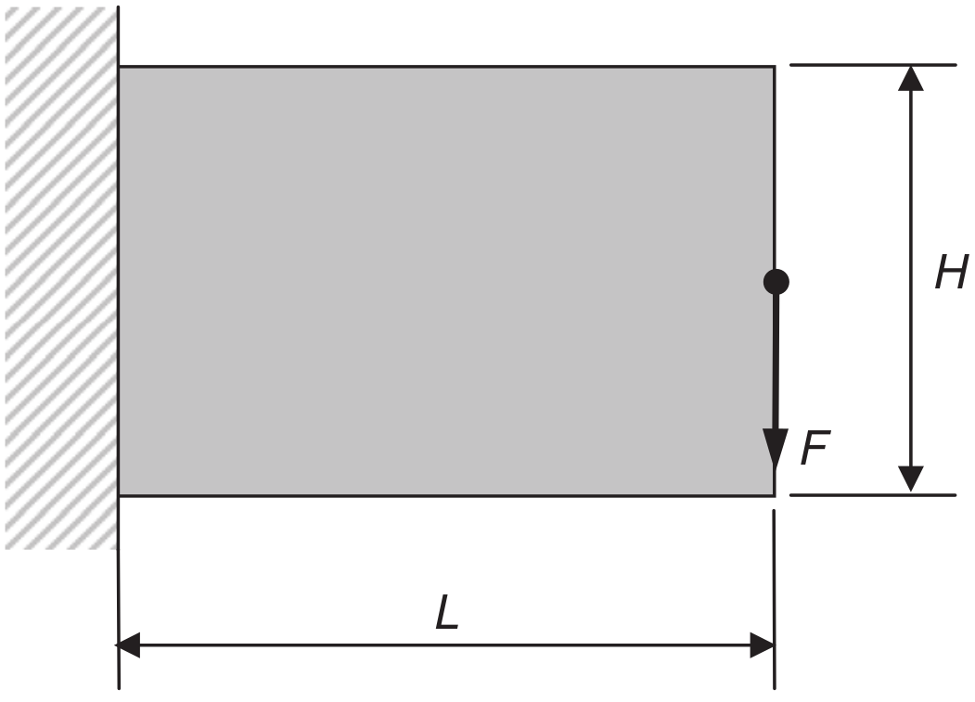
Optimization Problem
Figure: Schematic Diagram of MBB Beam
This is not the problem needed to be solved in order to answer the question of optimality of 2d structure of plants stems. By solving this problem, we are developing and testing our code for generating two scale optimal 2d structure.
Figure: Schematic Diagram of Cantilever Beam

Slide 13
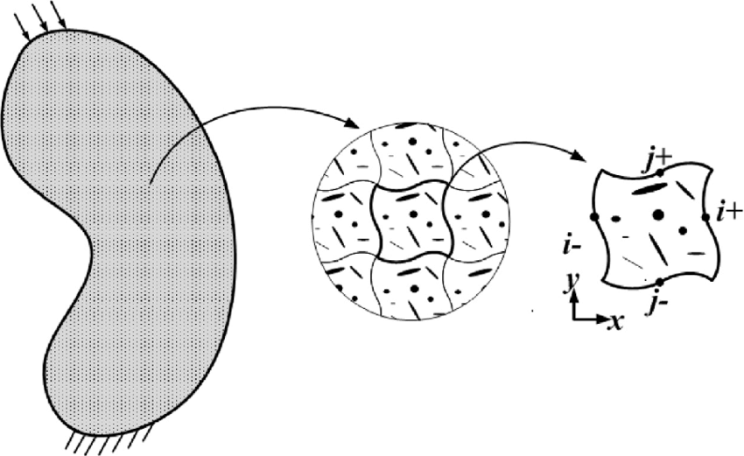
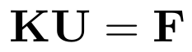
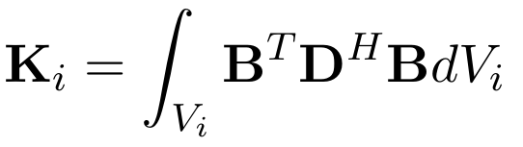
Periodic Microstructures
For obtaining the periodic microstructures as found in plants, finite element equations need to be solved at two scale. At macro scale
For each element
D^H is homogenized elasticity matrix. For calculating, D^H second finite element equation needs solved by applying periodic boundary condition. The concepts and implementation of homogenization and periodic boundary conditions will be discussed in coming slides.

Slide 14
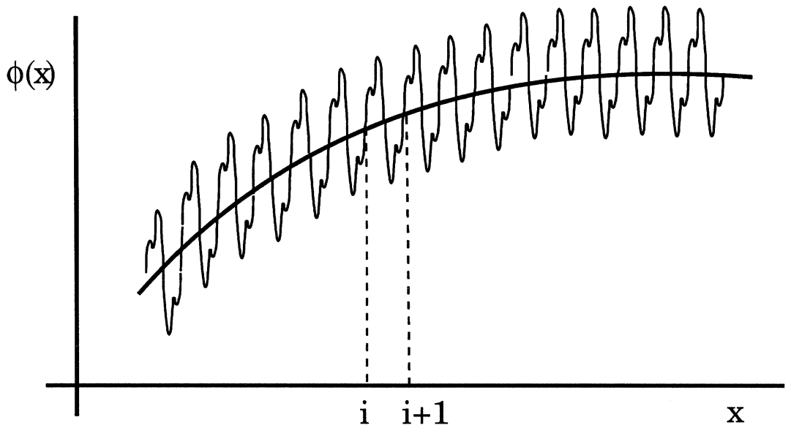
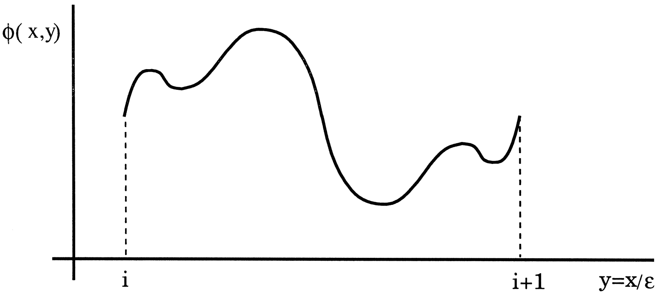
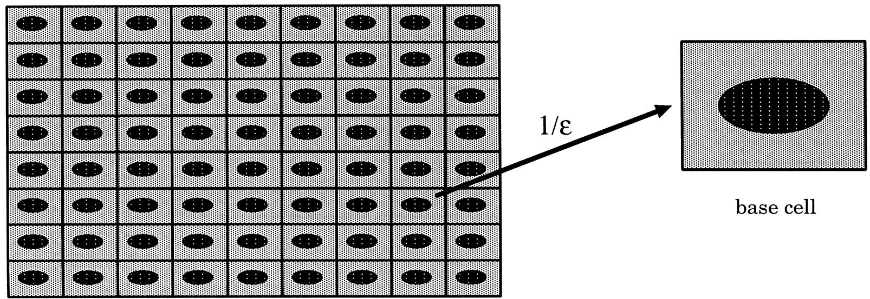
Homogenization
The homogenization method is based on the two-scale asymptotic expansion of structural responses. Using this, any field can be expanded as
Due to the complexity of analysing structures with cellular microstructure, the overall performances of one such structure are often studied by modelling the cellular core as a homogenized medium with effective elastic tensor.
Figure: An oscillating function
Figure: One of the oscillation in the expanded scale
Figure: Characteristic dimension of inhomogeneity and scale enlargement

Slide 15
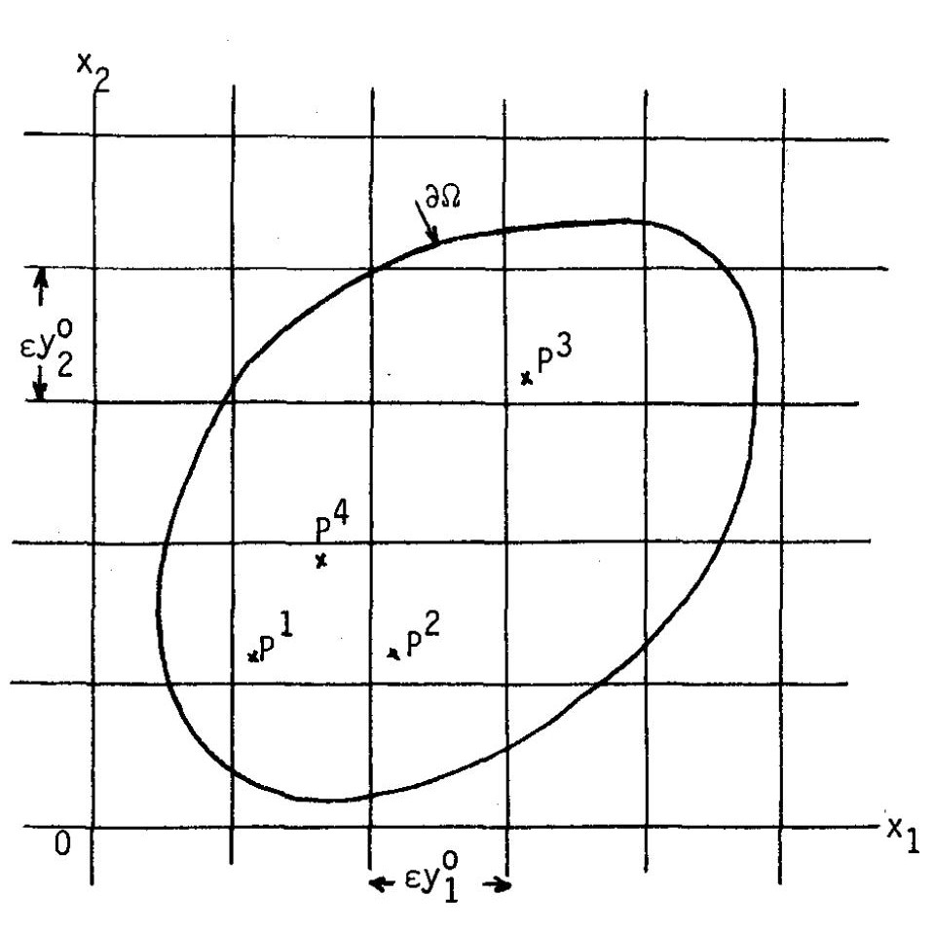
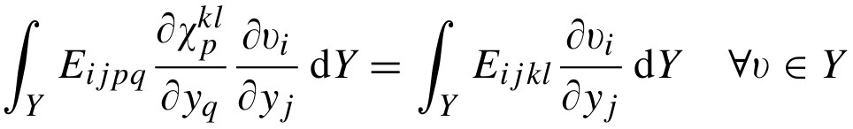
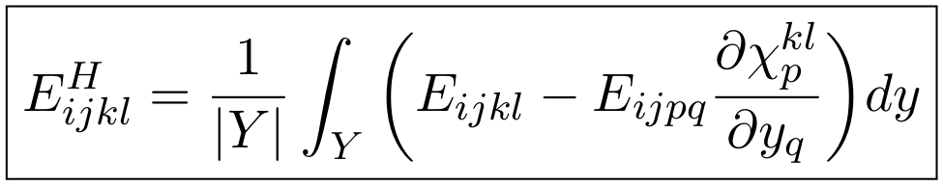
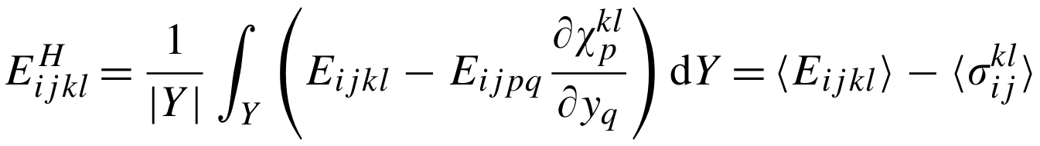
Homogenization
The homogenized equilibrium equation become
The equation for homogenized Elasticity tensor is
is the strain field in the base cell
Alternatively, we can write
Figure: Schematic for periodic microstructure and double scale modelling
denotes the averaged elastic tensor whereas , the averaged stress tensor associated with the displacement vector over the unit cell in load case kl, is a correction term reflecting the influence of the material microstructure of the unit cell

Slide 16
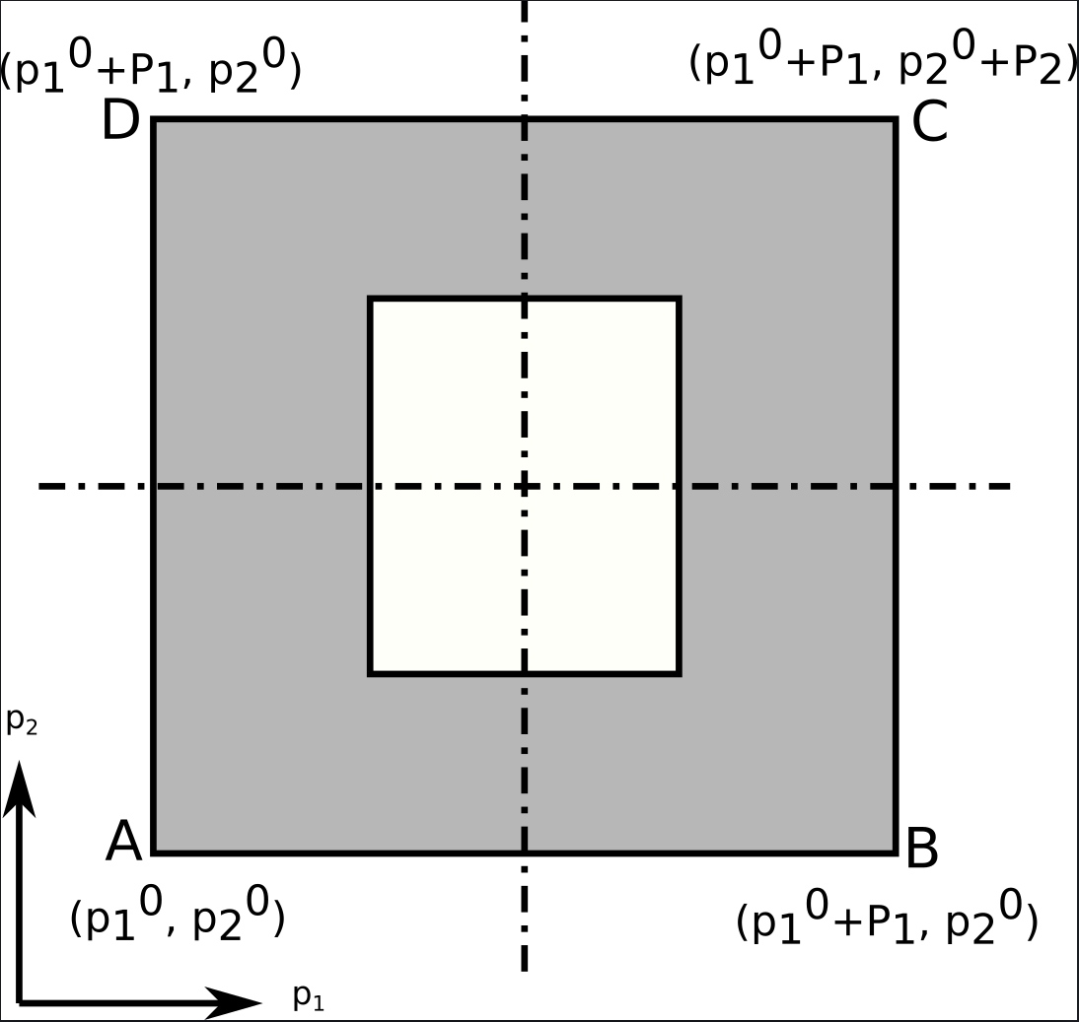
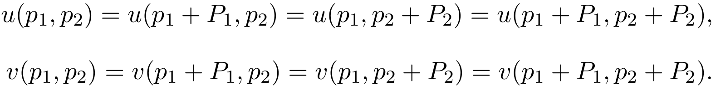
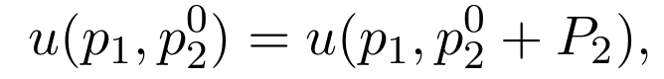
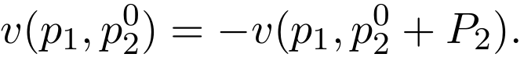
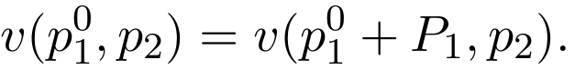
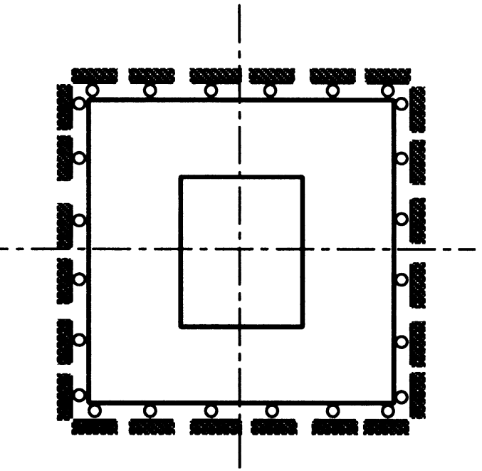
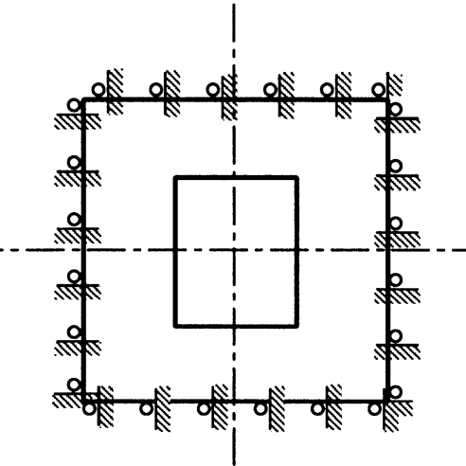




Periodic Boundary Conditions
q2
The process of homogenization requires the displacements corresponding to uniform strain fields, i.e.
From periodicity, we have
q1
For [1 0 0]T and [0 1 0]T strain fields
From symmetry of loading about q1 and periodicity, we get
Therefore, final set of PBCs
Figure: Representative Base cell
Similarly, from symmetry of loading about q2 and periodicity, we get
Similarly for the case [0 0 1]T, we have following PBCs
(a)
(b)
Figure: (a) PBCs for [1 0 0]T and [0 1 0]T cases, (b) PBCs for [0 0 1]T case

Slide 17



Penalty Method
Let these conditions on the displacements {U} can be written as
[C]{U} = {Q}
Let {t} be the difference between [C]{U} and {Q}
{t} = [C]{U} − {Q}
such that {t} = {0} implies that the constraints are satisfied.
We modify the potential energy term to include a penalty term
Π = ½{U}’ [K]{U} − {U}’ {F} + ½{t}’[α]{t}
For minimum potential energy condition, {∂Π/∂U} = {0}, this implies
([K] + [C]’[α][C]){U} = {F} + [C]’[α]{Q}
All constraints are given equal priority therefore [α] = α[I] and α is significantly large to ensure constraint violation is negligible.
([K] + α[C]’[C]){U} = {F} + α[C]’{Q}
(a)
(b)
(c)
Figure: Deformation of the base cell for the strain fields (a) ε = [1 0 0] T, (b) ε = [0 1 0] T, (c) ε = [0 0 1] T

Slide 18











Implementation
For 2D problems, it is sufficient to solve for i, j, p, q = {1, 2} and three cases for {k, l} = {1, 1}, {2, 2}, {1, 2}. Assuming orthotropic material and removing terms with zero coefficients
We can rewrite this equation as
where
Assembling all the equation, we get
Similarly, we can derive
where

Slide 19





Sensitivity Analysis
Sensitivity Analysis is necessary for linking the design variables, i.e. topology of the microstructure to the objective function, i.e. Compliance of the macrostructure.
Compliance of one base cell is
The macrostructure is composed of identical base cells. The sensitivity of the compliance of complete structure w.r.t the relative densities of microstructure will be the average of sensitivities of compliance all elements w.r.t. the base cell design variable. i.e.,
Using D^H definition from homogenization
Figure: Schematic for periodic microstructure and double scale modelling
The sensitivity number are obtained by multiplying out the constants

Slide 20




Filtering
Numerical instabilities such as checkerboard pattern, mesh dependent solution arises in topology optimization problems. To deal with these problems, a mesh independency filter is applied to the sensitivity numbers. The modified sensitivity numbers are
where
Further, gradual improvement in the topology, an average is taken with sensitivity numbers of previous iteration. The sensitivity numbers become
Figure: (a) Design Problem (b) Checkerboard Pattern, Solution for mesh with (c) 600 elements, (d) 5400 elements

Slide 21

Procedure
Step 1: Initialise the design variables x_j’s, set parameters: filtering radius r_0 , delta δ. Define material properties, elasticity matrices D and densities ρ.
Step 2: Find microscopic displacement field û using finite element analysis by applying periodic boundary conditions.
Step 3: Find the homogenized elasticity matrix of the base cell.
Step 4: Determine the macroscopic displacement U through finite element analysis using homogenized material properties D H . Calculate compliance C of structure
Step 5: Do the sensitivity analysis to find sensitivity numbers α_j’s
Step 6: Apply the weighted mean filter to obtain filtered sensitivity numbers αˆj’s
Step 7: Determine the volume target for the current iteration as following
Step 8: Sort the filtered sensitivity numbers and set the design variable x j s corresponding to the top NVf^t sensitivity numbers to 1 and the other to 0.
Step 9: Repeat steps 2 to 8 until the target volume is reached and the convergence criteria is met.

Slide 22




Examples

Slide 23




Examples

Slide 24




Examples

Slide 25




Examples

Slide 26
Conclusion
In this thesis, we have studied the optimality of areal distribution of material across a cross-section of the bamboo and laid down methods and developed tools for studying the optimality of 2D structure and microstructure of the bamboo.
To provide an establishing answer to the question of structural optimality of plant stems, further simulation need to be done for the optimality of 2D structure and the ideas presented here need to be expanded to 3 dimensions to get deal with the complete structure of plants stems.

